Slide 1
Web Clinic IT GWU
It.gwu.edu

Slide 2
Reviewed by: Sharon Austin, Web Applications Specialist, USFSP Robert Beasey, Student, USFSP Special Thanks to: Kara Gillepsie, GWU

Slide 3
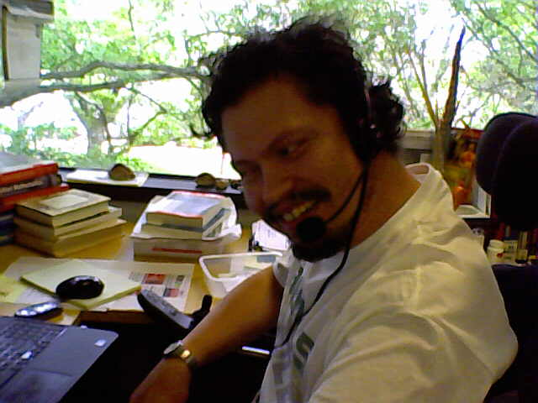
And very especial thanks to: Robert Beasey, USFSP

Slide 4
How evaluation was done…
First, an overall view of the site by myself, responding only to visual cues. Then I tabbed through the site to see if I could reach all areas by keyboard only. I asked myself if the content and the terminology made sense to a newcomer. Finally, I used some developer tools to evaluate the site.
Next, I asked Robert to come in and evaluate the site…..
There was a strong match in our assessment, and the ability to see the site through Robert’s eyes came about for only one reason: I worked with him on a regular basis.
The Bottom Line: Involve testers with disabilities on a regular basis.

Slide 5
Awesome Site!
Much more “right” than “wrong” so kudos to it gwu!

Slide 6
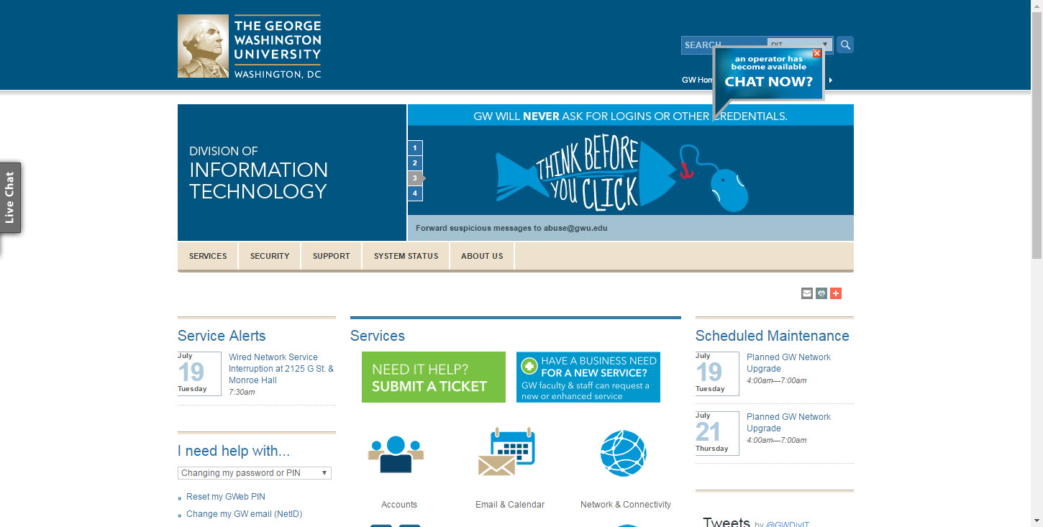
Robert: Chat Now is hard to follow, hard to use (moving target, small print, colors too similar to background, and the lettering above the words, “Chat Now” is too small).

Slide 7
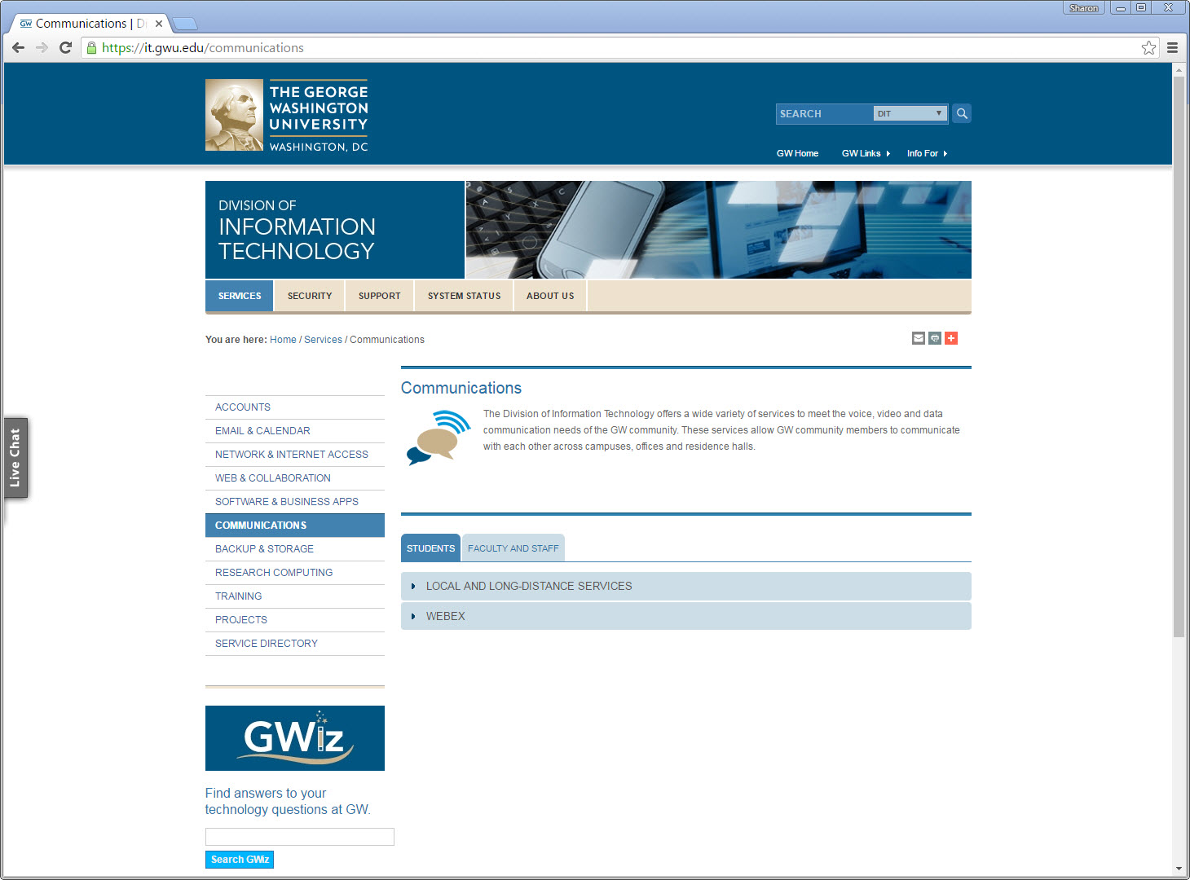
Robert: Communications Icon seemed to be a duplicate of the “Chat Now” function, so there was a little confusion over what he supposed to do.

Slide 8
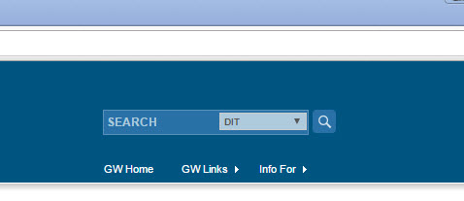
Robert: The search bar is very hard to see, and he cannot read the lettering inside the light blue portion of the search bar. When the letters were read out loud to him, the letters, “DIT” had no meaning. He also did not see the dropdown.
https://www.cludo.com/en/blog/search-vs-navigate-people-behave-websites-search-navigate/

Slide 9
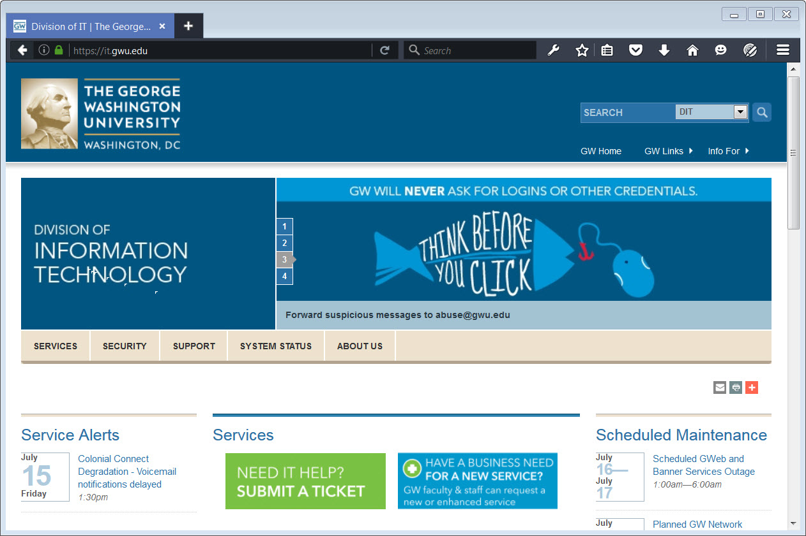
Carousels are Evil….
http://shouldiuseacarousel.com/

Slide 10
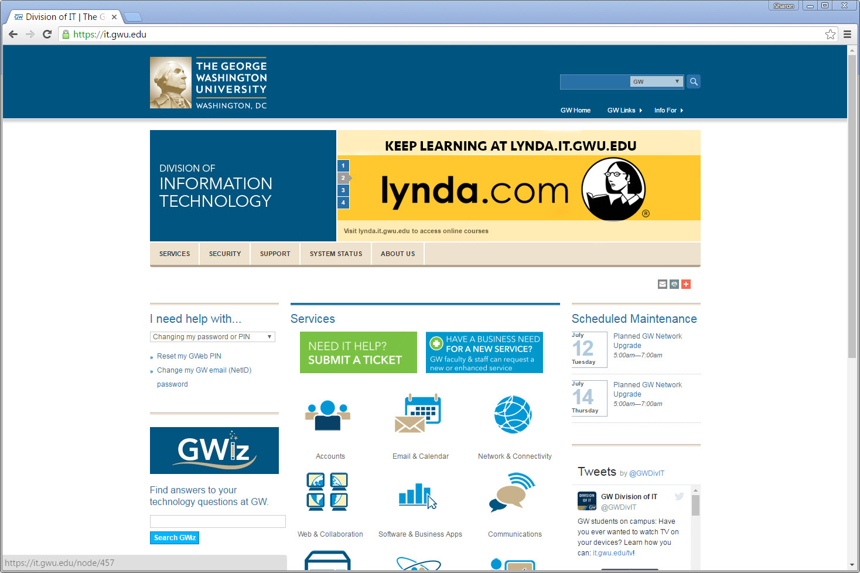
Important content areas do not stand out, so in terms of “visual communication” content importance does not align with the visual hierarchy. This matters greatly for those with weak vision skills, and for general cognition.

Slide 11
Those with disabilities rely heavily on tabbing to navigate through a site. On this site, visual Indicators are difficult to see.
One of the elements has focus on it right now, but it is hard to tell by looking which element has focus.

Slide 12
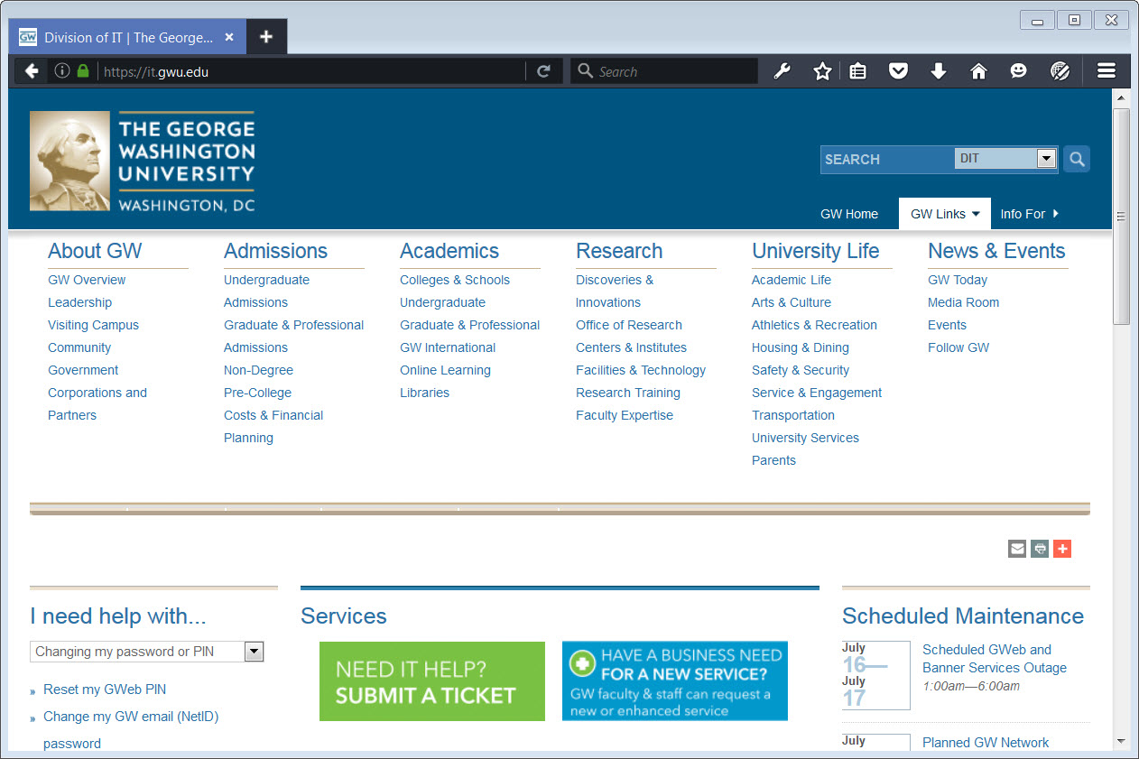
This content must rely on the click of a mouse, or specialized knowledge of how to use a screen-reader to access.

Slide 13
Search is an extremely important feature on any website, not only for those with physical disabilities, but those with cognitive disabilities. This configuration is problematic on a visual level, an accessibility level, and for usability.

Slide 14
Use Screen Readers to test, but always, always remember…..
YOU are NOT AN EXPERT…
The ONLY experts are those with disabilities who rely on the technology. If you have use of your eyes and hands, you can never be an expert without dedicated, targeted, years of study.

Slide 15
So why do I use screen-readers?
I am NOT AN EXPERT…
It helps me to get a feel for how the other half lives, to test code, and to “narrow down” my questions to ask Robert on the chances I get to work with him. Time is not unlimited.

Slide 16
Keep in mind….
Just because it passes a screen-reader test doesn’t make it accessible…
Those with low-vision rely on different cues than the linear path presented by screen-readers

Slide 17
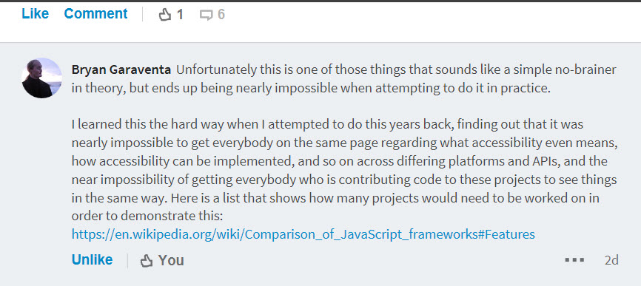
About working with screen-readers, as observed by a blind developer

Slide 18
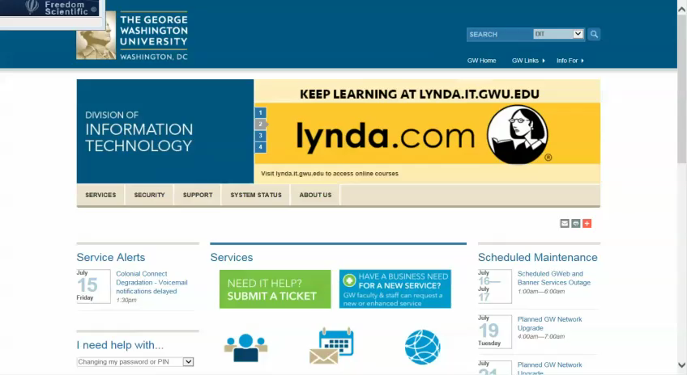
What would a screen reader see?

Slide 19
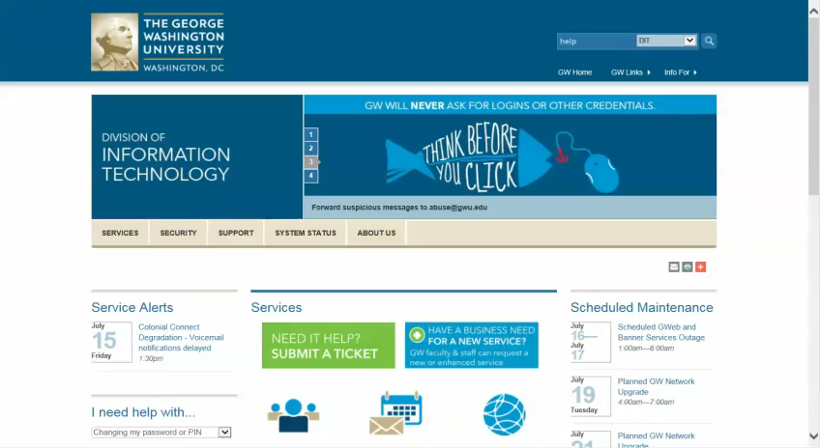
Another screen reader…

Slide 20
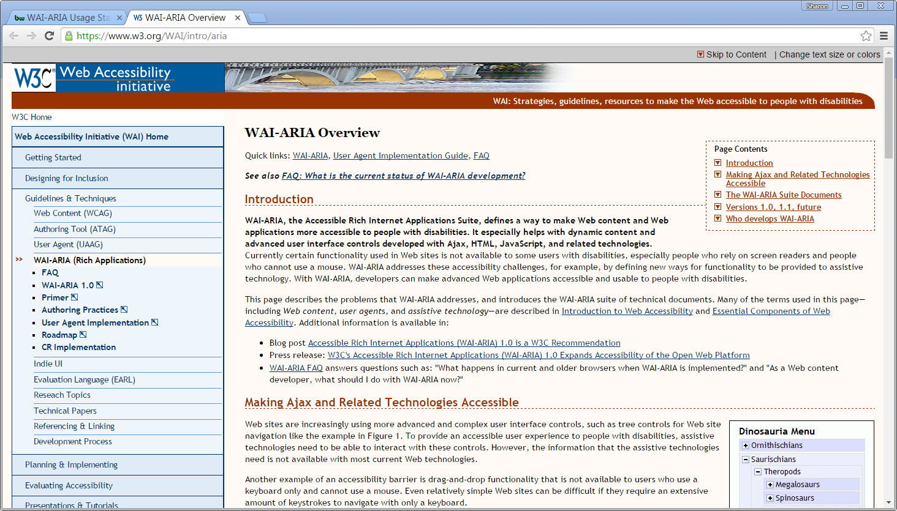
General Guidelines…

Slide 21
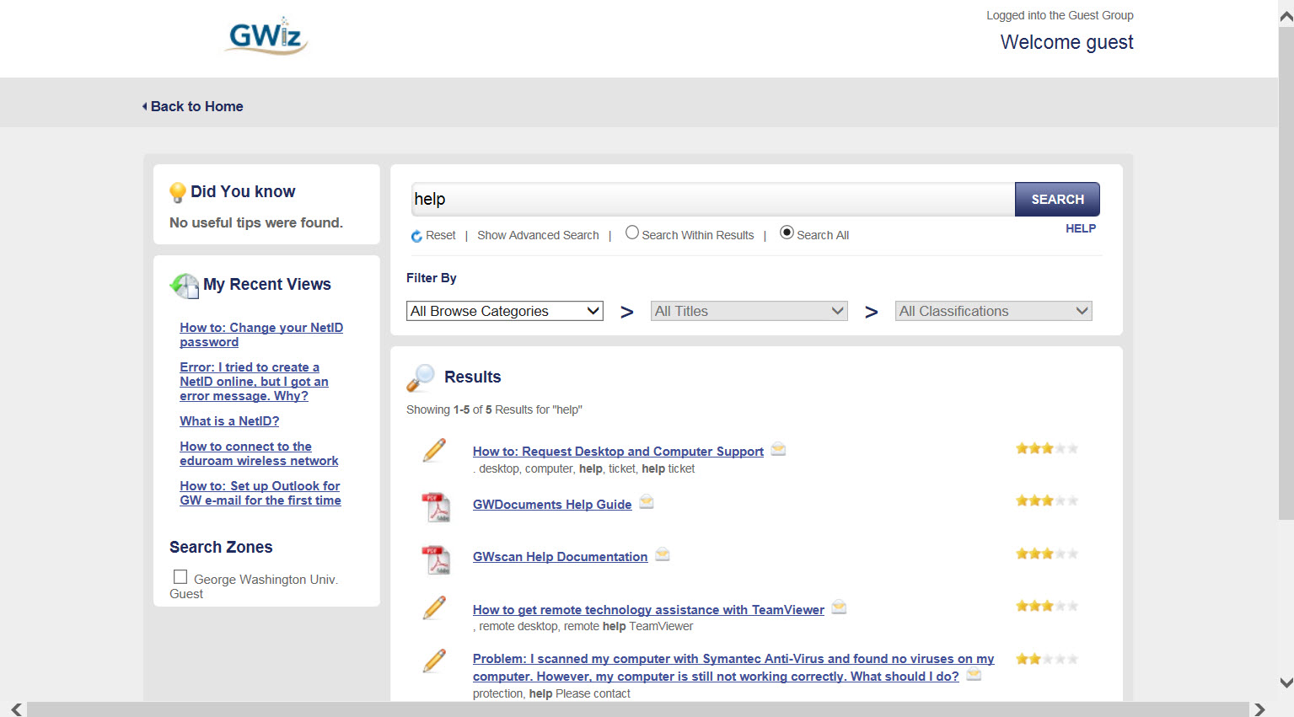
This page did well with screen-readers..
From typing “help” in lower search box

Slide 22
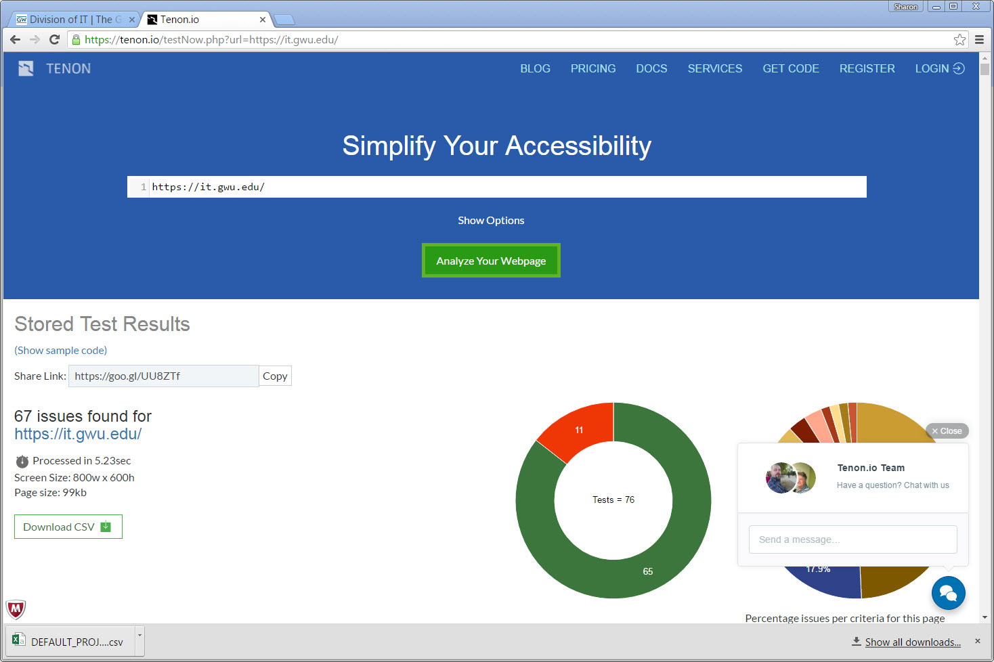
Tools to help…tenon.io

Slide 23
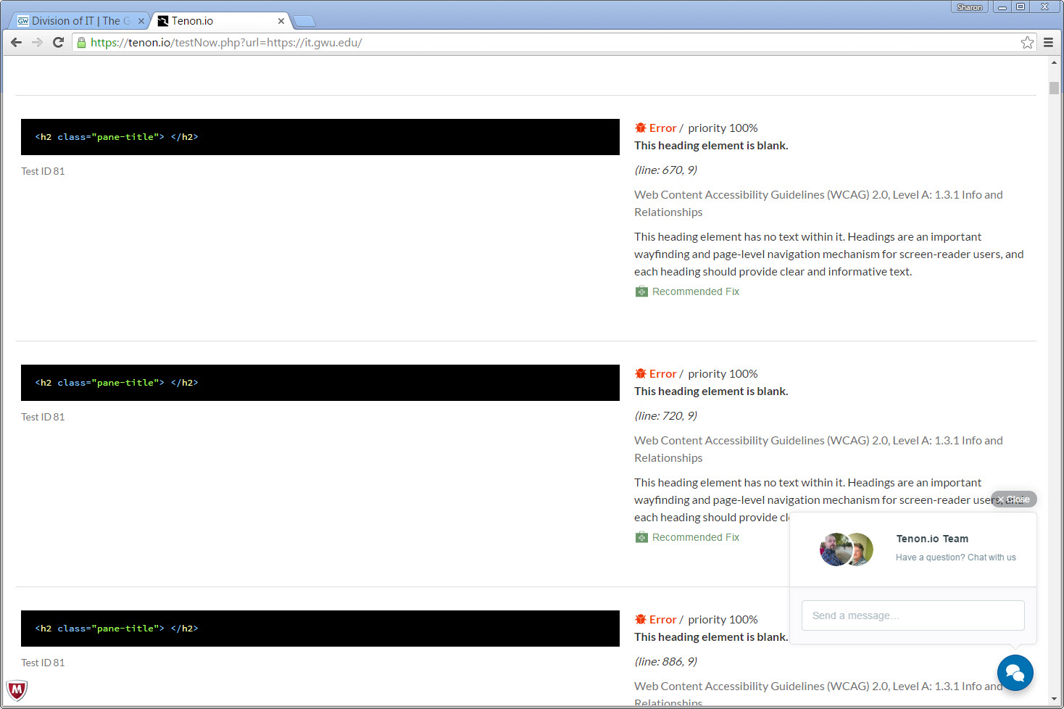
Tools to help … tenon.io
Screen readers often navigate by headings…leaving them empty sends blind users on a wild goose chase for content.
Also, please ensure headers are in a logical order…h2 before h3, and don’t use for styling.

Slide 24
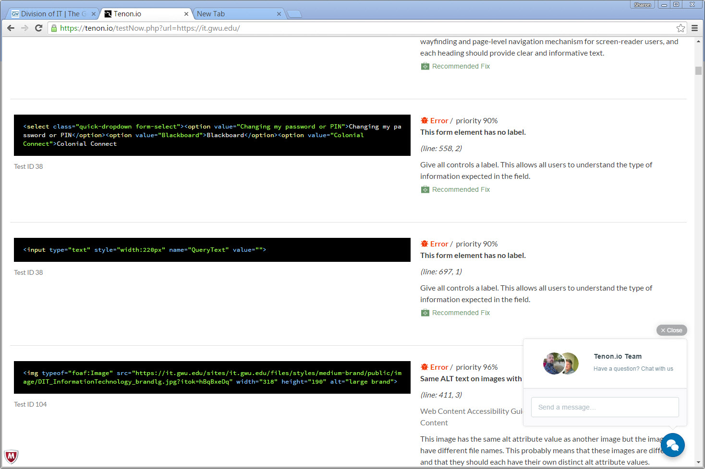
Tools to help … tenon.io
Support this, and all such tools, if you can. Sign up and/or donate.

Slide 25
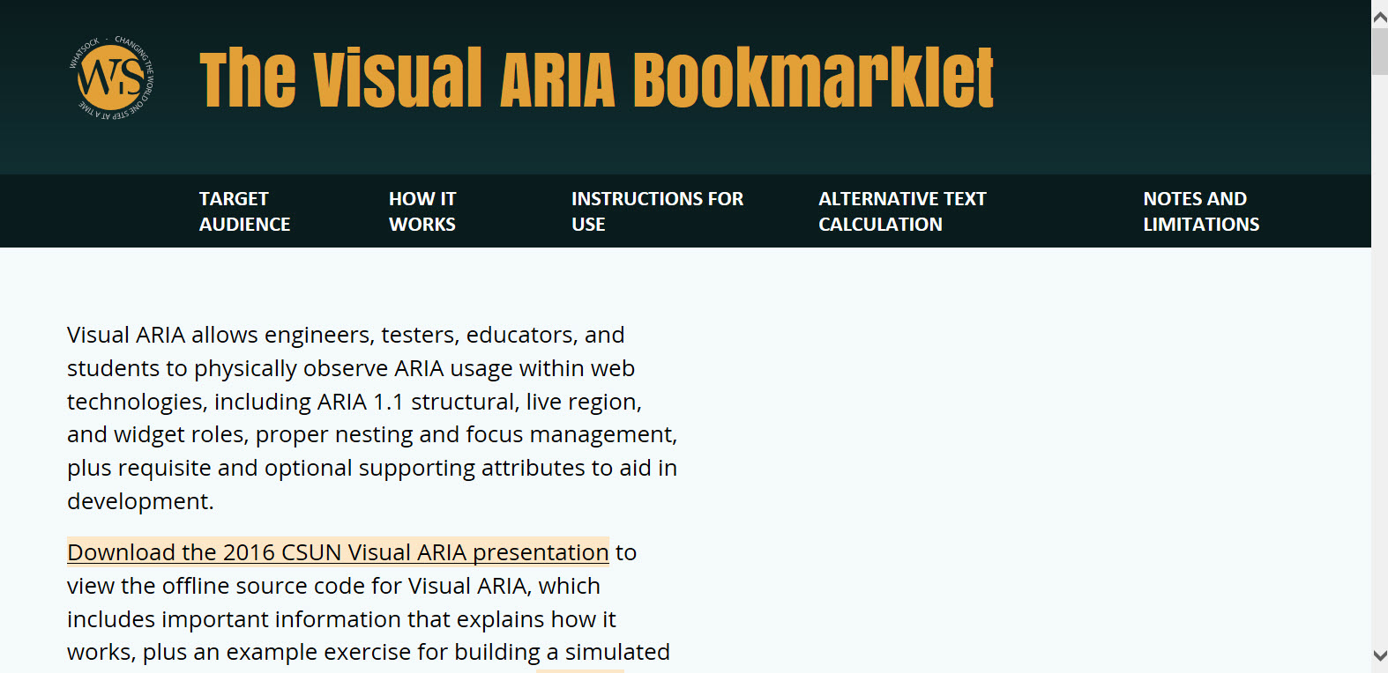
Tools to Help….
Caution when using aria…can do more harm than good if used incorrectly…..test, test, test, and test some more with actual blind users.

Slide 26
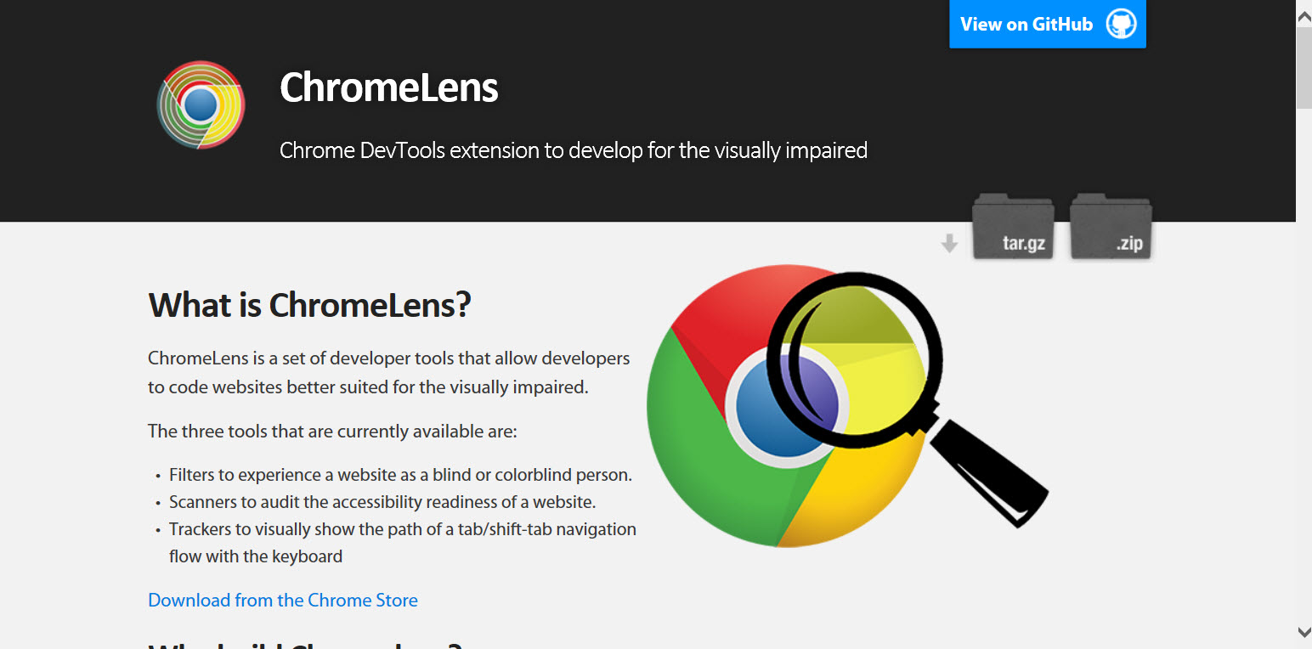
Tools to help … ChromeLens
https://chrome.google.webstore

Slide 27
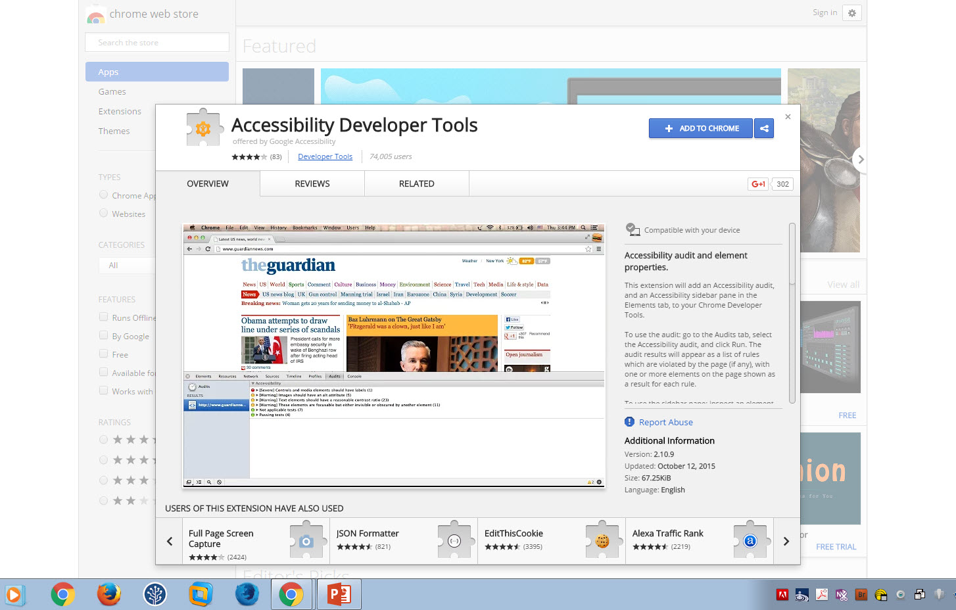
Tools to help …. Chrome Plugins
https://chrome.google.com/webstore

Slide 28
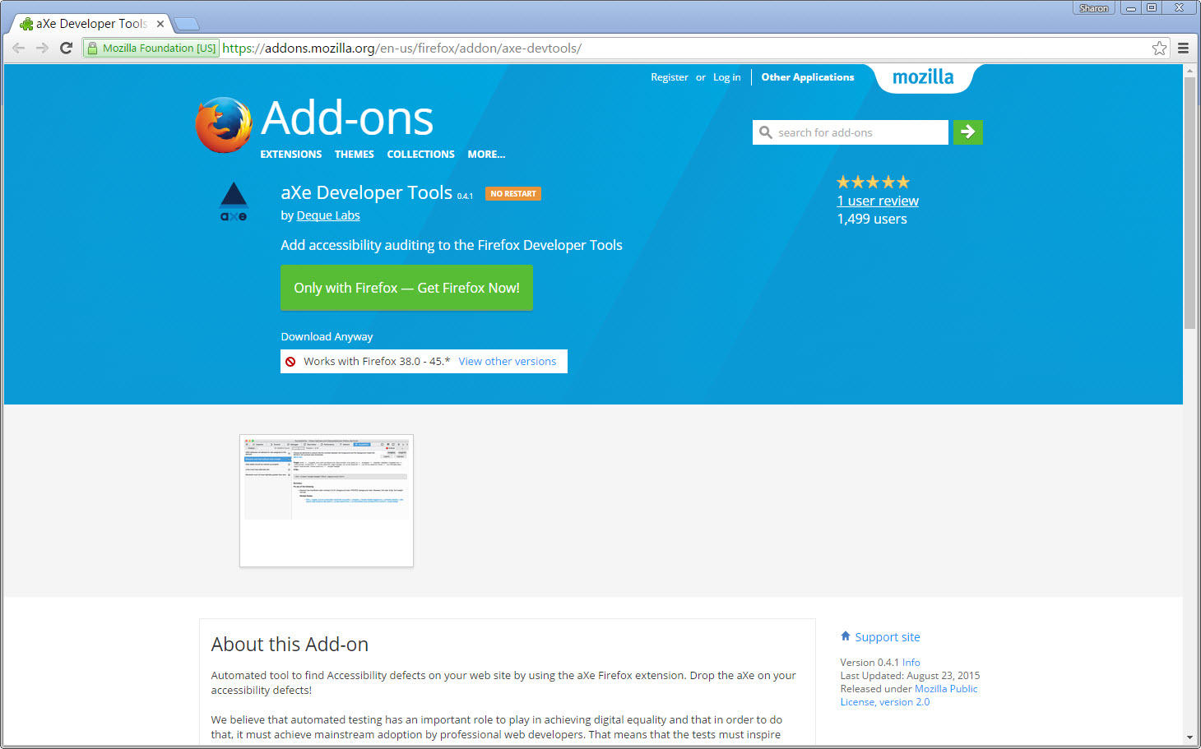
Tools to help … Firefox
https://addons.Mozilla.org/en-us/firefox/addon/axe-devtools

Slide 29
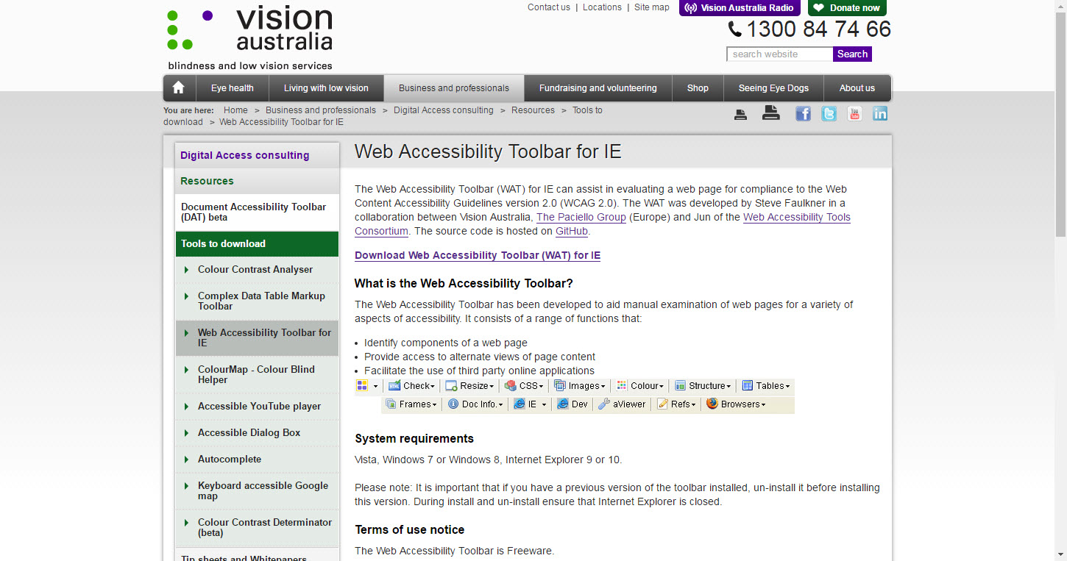
Tools to help … IE
www.visionaustralia.org/digital-access-wat

Slide 30
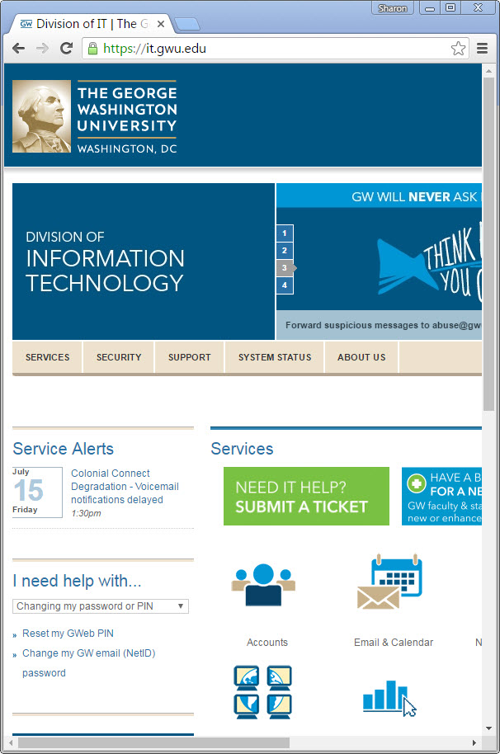
Usability is a kind of accessibility too.
At a minimum, sites need to be mobile friendly. A narrow screen hides the search box on this site, creating problems for individuals with certain disabilities.
Article in 2015: Mobile Searches Surpass Desktop Searches At Google For The First Time
https://techcrunch.com/2015/10/08/mobile-searches-surpass-desktop-searches-at-google-for-the-first-time/

Slide 31
What this means…..
Can’t rely on click events alone…
Small file sizes…..gigantic images, or resource-intensive processes may effectively prevent some of your users from accessing content

Slide 32
Questions?
Thank you!

